Slide 1

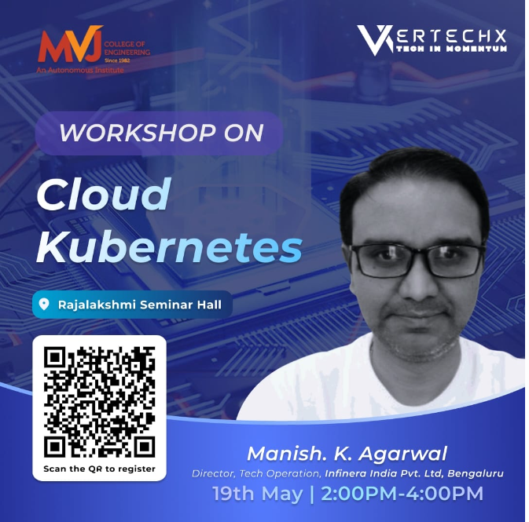
Kubernetes

Slide 2
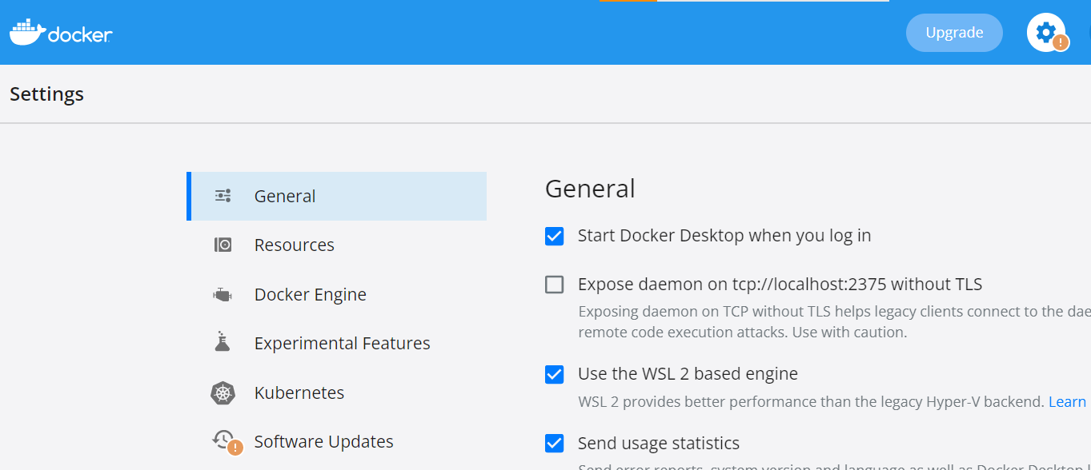
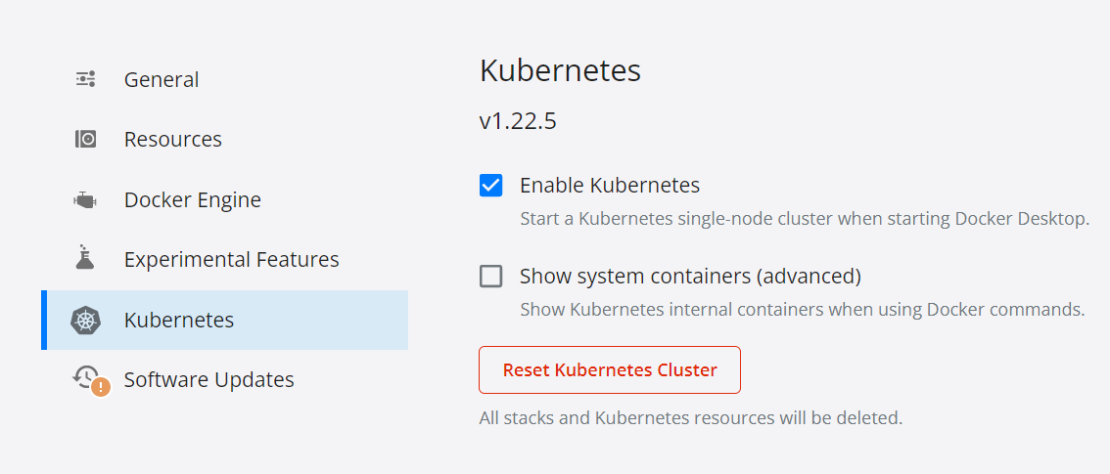
Follow along
Step#1
Install Docker desktop on you machine
Step#1 – Settings
Step#2 – enable Kubernetes
Limitations:
Single master node
Other Options: Next slides
Step#2

Slide 3
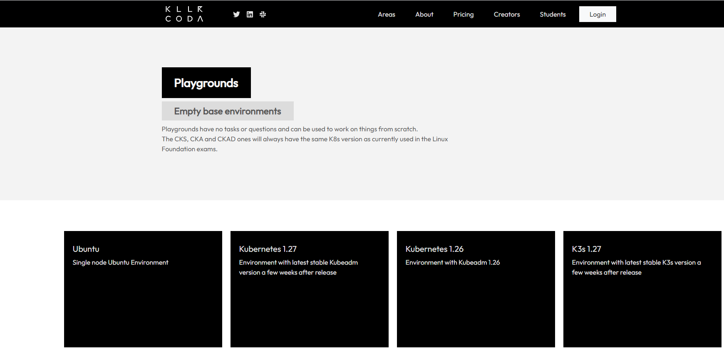
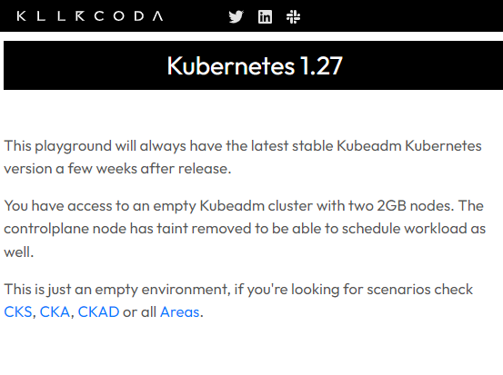
Turn up Options - Killercoda
https://killercoda.com/playgrounds

Slide 4
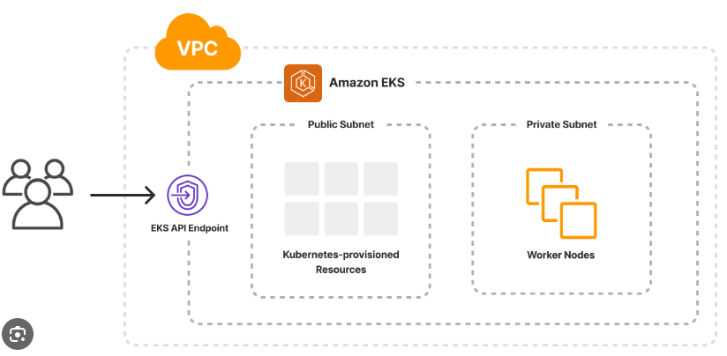

Turn up AWS cloud - EKS
Elastic Kubernetes service – Fully managed
Step#1:
Create an IAM role
Create a a VPC
Create EKS cluster
May take upto 10-15 mins
You pay $0.10 per hour for each Amazon EKS cluster that you create

Slide 5
Agenda
Setup
Docker Desktop
Concepts
Why, What
Turnup
How ?

Slide 6

Why K8s ? Interesting fact
Kubernetes aka K8
K | u | b | e | r | n | e | t | e | s
K | 1 | 2 | 3 | 4 | 5 | 6 | 7 | 8 | s
Now maintained by cloud native computing foundation

Slide 7
Why ?

Slide 8
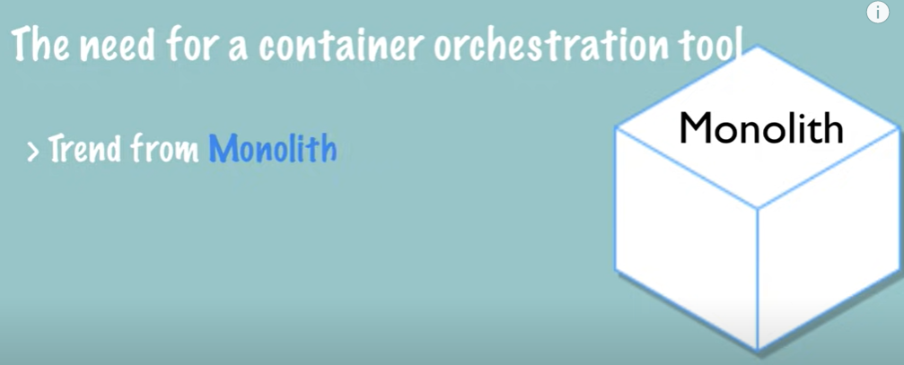
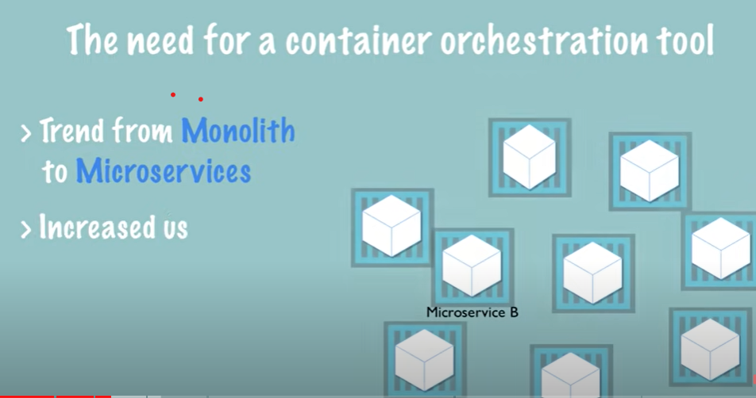
Why Kubernetes ?
Custom scripts
How do I manage this Infra ?
Standard frameworks
Assuming “why containerization” is understood Reference slides next

Slide 9
What does the management of containerized infra mean ?
High availability
Service discovery
Node replication
Load balancing
Automated scaling
Container monitoring
Container logging
Security management
User management
It is like someone wanted to build a website for business and the first thing they started with was building an OS

Slide 10
Why containerization ?
Light weight, re-use of underlying Kernel
Dependency isolation
Consistency in dev, test and production environments
Automation of INFRA bring up, monitoring and disaster recovery.
Containers: App and all its dependencies at app level and system level packaged together
Docker is one framework that can be used to run and manage a containerized application
Reference offline review

Slide 11
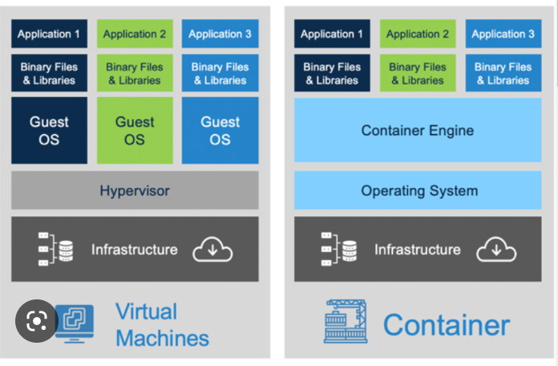
Containers Vs VM
Each VM has own OS
Multiple OS and Kernels
Higher disk space
Slow boot (entire OS)
Complete Isolation
Mix of windows and Linux OS on same HW
Reference offline review

Slide 12
Busting the Myth ?
Can you run a windows based container on a Docker engine installed with Linux kernel ?
If no why ?
Docker
Windows use a different Kernel
System OS
Docker can run any OS “as long as” they are based on same Kernel (say Linux) eg Ubuntu, Debian, CentOS
Unlike hypervisors Docker is not meant to virtualize different OS and Kernel on same HW

Slide 13
Cloud Native with Kubernetes
Software approach of building, deploying, and managing modern applications in cloud computing environments
Cloud-enabled and cloud-based
Cloud enabled – Upgrades need a down time
Cloud-based/native: scalable, flexible, and upgraded without service interruptions

Slide 14
What ?

Slide 15
What is Kubernetes ?
Container and service orchestration framework
Manage applications that can be made of 100s and 1000s of containers
Multiple deployment environments: Physical, VMs and cloud
Auto scale
High availability
Portable
Extensible
Open-source platform
Declarative config and automation
BLUE/GREEN deployments

Slide 16
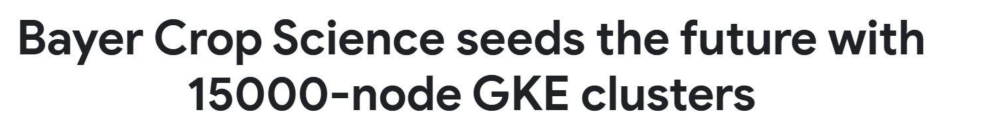
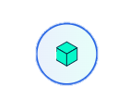
K8s scalability ?
Kubernetes v1.27
Cluster size
5000 nodes/cluster
110 pods/node
No more than 110 pods per node
No more than 150,000 total pods
No more than 300,000 total containers

Slide 17
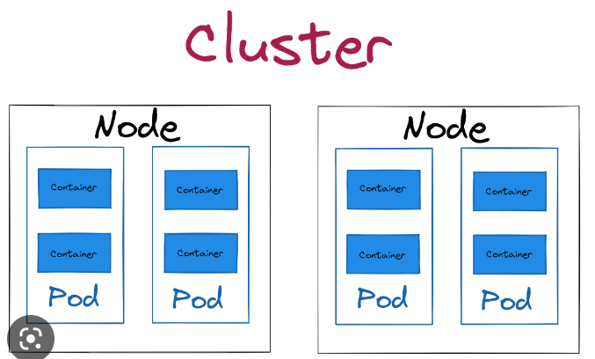
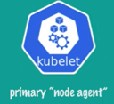
K8 architecture
Cluster is group of nodes ( SPOC and load sharing)
Control plane(master node) with K8 components
1 master(typical) many worker nodes
Multi master is possible
1 containerized application /pod is most typical
2 containers per pod (helper pod, monitoring pod) – “side car”
Master
Worker

Slide 18
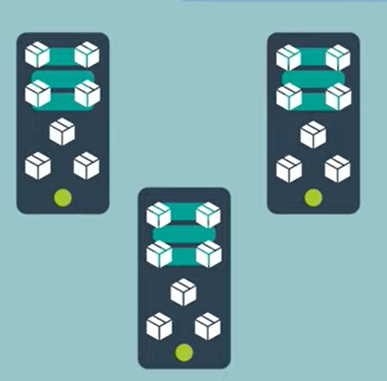
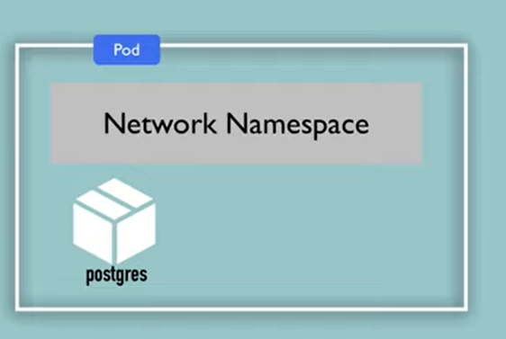
Pod: Container abstraction
Challenge:
With many containers running on same host
Eg:
Instance 1# Postgres(5432) -> host port say 5001
Instance 2# Postgres(5432) -> host port say 5002
With 100s of instance you will lose track of which host ports are available
Every Pod has unique IP(and virtual Ethernet connection) and reachable within cluster
The port mapping will be inside the pod and in generally pod will not have ~6 containers.
Container runtime are abstracted ( docker or vagrant)

Slide 19
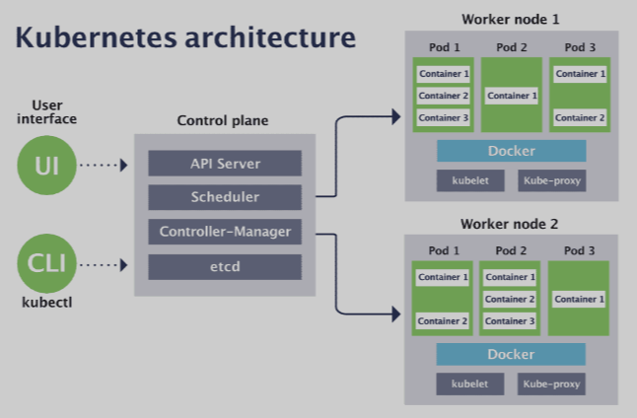
K8 components - Clients
UI clients
Kubernetes Dashboard (kube-dashboard) [most mature and popular]
Lens [most powerful one]
Octant [easy to install and most portable]
kubenav [Android and iOS support]
Kubectl
kube control
Command line tool to communicate with cluster’s control plane
https://kubernetes.io/blog/2021/03/09/the-evolution-of-kubernetes-dashboard/

Slide 20
K8 components – Control plane
Control plane
Kube-apiserver:
Exposes Kubernetes api
Frontend of Kubernetes control plane
Etcd
Highly distributed available key-store (configuration data, state data, and metadata of the cluster)
Kube-scheduler:
Assigns newly created pods and assigns node to them
Kube-controller-manager:
All controllers are compiled into single binary and run as single process
Node-controller, job-controller9created pods to run jobs), serviceaccount controller

Slide 21
K8 components – Node
Node components
kubelet:
Agent running on nodes, 1 per node
Frontend of Kubernetes control plane
Kube-proxy
Network proxy, maintains network rules on nodes
Container runtime :
Software responsible for running containers
Docker(containerd)
Rocket (from coreOS)
Vagrant(hashicorp)

Slide 22
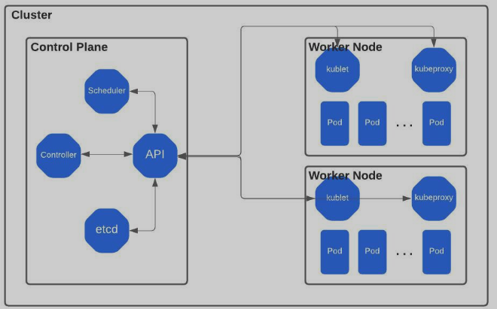
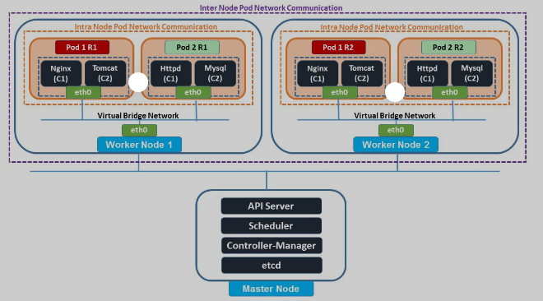
Kubernetes networking
https://kubernetes.io/docs/concepts/services-networking/

Slide 23
Declarative definition for application
Say you need
Webserver – 3 instances
Payment service – 3 instances
Database service – 3 instances
Kubernetes will turn up and the state is always maintained.
Will turn up instances in case some instance go down.
What is the other way of programming – Imperative
Why is declarative definition important ?

Slide 24
Imperative Programming | Declarative Programming
1. Computation
step-by-step instructions for how | You set the conditions that trigger the program execution to produce the desired results.
2. Readability and complexity
As you add more features and code to your program, it can become longer and more complex, | Step-by-step processes are eschewed. less complex and requires less code, making it easier to read.
3. Customization
You have complete control and can easily adapt the structure of your program to your needs. | Customizing the source code is more difficult
4. Optimization
Adding extensions and making upgrades are supported, but doing so is significantly more challenging . | You can easily optimize code because an algorithm controls the implementation.
5. Structure
The code structure can be long and complex. | The code structure is concise and precise,

Slide 25
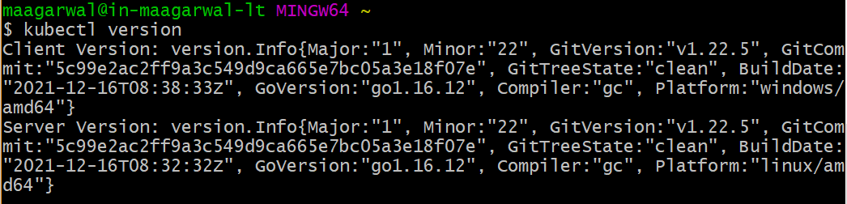
kubectl
To operate the K8 cluster
Cube CTL, Cube control, Cube cuttle
kubectl version
kubectl –help

Slide 26
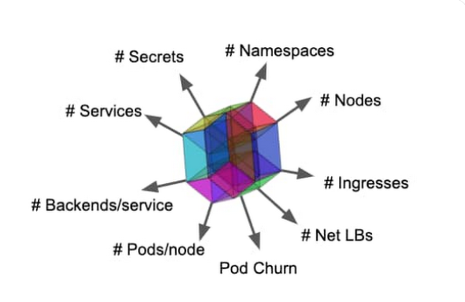
K8 object types
Nodes, Pods, Services
Namespace: Isolate group of resources in a cluster
configMap: non confidential data in key-value pair(env variables)
Ingress:Ingress exposes HTTP and HTTPS routes from outside the cluster to services within the cluster.
Net LBs : Network Loadbalancers
Secret: Sensitive data such as password, token or key
https://kubernetes.io/docs/reference/kubectl/cheatsheet/

Slide 27
Turn-up

Slide 28
Follow along
You can follow along if you have turned up a Master node
Step#1
Install Docker desktop on you machine
Step#1 – Settings
Step#2 – enable Kubernetes
Limitations:
Single master node
Other Options: Next slides
Step#2

Slide 29
Environment settings
alias k=kubectl
complete -o default -F __start_kubectl k
set expandtab
set tabstop=2
set shiftwidth=2
set autoindent
set smartindent
set bg=dark
set nowrap
set paste

Slide 30
Create your first pod
Assuming we have the containerized applicable available in a local or remote registry
Application containers are encapsulated in a pod
kubectl run mvjnginx --image=nginx
Where does it get the image
Downloaded from docker repository(default) or a private repository
kubectl get pods

Slide 31
Imperative Vs declarative ?
Can the above scale where you run multiple commands multiple times to turn up and later tear down pods ? YES / NO ?
Would it not be nice if you can define the specification of the object(Pod) in a file and have K8 apply the config. This way you can define the state and services of your application as code and version control them
Kubernetes uses YAML spec files

Slide 32
Imperative pod turnup
kubectl run mvjnginx --image=nginx
Very simple example not of much use in real time scenarios where we you have to define a lot of other attributes like node affinity, ports, resource limits etc.
All of them can be defined using command line but too cumbersome and error prone

Slide 33
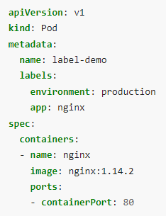
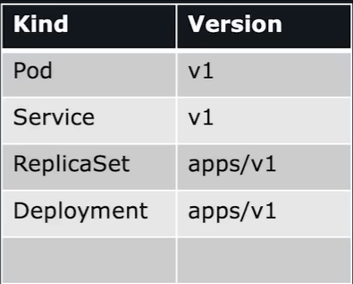
Declarative pod turn up
apiVersion -> Kuberentes api version – v1
Kind: object type = Pod
Metadata:
Name: <some label>
Labels:
<some label1>
<some label2>
Spec:
Containers encapsulated in the pod
kubectl get pods -l environment=production
dict
dict
list
Application port
https://www.youtube.com/watch?v=o9pT9cWzbnI

Slide 34
Create a pod with yaml(manifest file)
Kubectl create –f pod-definition.yaml
Shortcut to create templates
kubectl run manipod --image=nginx --dry-run=client -o yaml > mvjpod02yaml.yaml
Kubectl get pods
Kubectl describe pod <pod-name>
Inside a running pod
k exec -it nginxpod01 -- ls -l

Slide 35
Some pod operations
Add a label to the yaml file
Apply the yaml file
Delete and apply the yaml manifest
k get pods -l env=test
Get pod events
k describe pod <podname> | grep -i events -A10
User cannot change a running pod but can change the template of the deployment

Slide 36
Node affinity application
Critical POD
POD
POD
Critical POD
Master node
Worker Node1
Worker Node2
Critical application

Slide 37
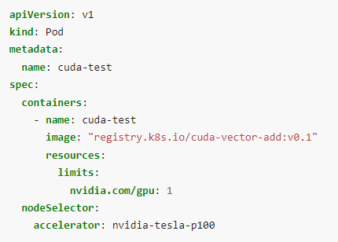
Forcing a pod on node
Node selector (on the pod):
Attracts the pods to a set of nodes
kubectl label nodes <your-node-name> disktype=ssd
Node affinity(on the pod):
requiredDuringSchedulingIgnoredDuringExecution
The scheduler can't schedule the Pod unless the rule is met
preferredDuringSchedulingIgnoredDuringExecution
The scheduler tries to find a node that meets the rule

Slide 38
Taints and Tolerations
Node affinity is a property of Pods that attracts them to a set of nodes (either as a preference or a hard requirement). Taints are the opposite -- they allow a node to repel a set of pods.
Tolerations are applied to pods. Tolerations allow the scheduler to sc
Taints and tolerations work together to ensure that pods are not scheduled onto inappropriate nodes. One or more taints are applied to a node; this marks that the node should not accept any pods that do not tolerate the taintshedule pods with matching taints

Slide 39
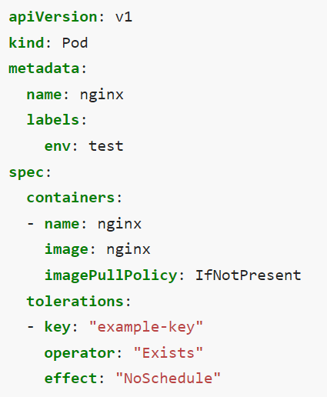
Taints(Node) and Tolerations(Pod)
Taints allow a node to repel a set of pods
kubectl taint nodes node1 key1=value1:NoSchedule
Tolerations are applied to pods:
Taint effect:
NoSchedule: expect matching toleration
PreferNoSchedule: soft
NoExecute: Evict existing pods
Use Case: Operator wants only high value jobs to get a specific node

Slide 40
Node Maintenance: Drain, Cordon
To safely evict all of your pods from a node before you perform maintenance on the node
Should only be issued to a single node at a time
kubectl drain node01
Will gracefully remove the pods
Cordon node: Does not move current Pods, no new pods
kubectl cordon node01

Slide 41
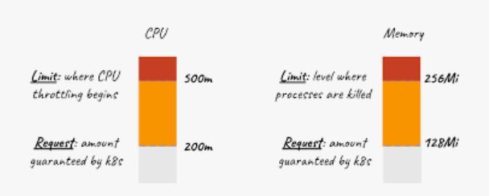
Resource request & limits on pods
Optionally specify how much of each resource a container needs
the most common resources to specify are CPU and memory (RAM)
kube-scheduler uses this information to decide which node

Slide 42
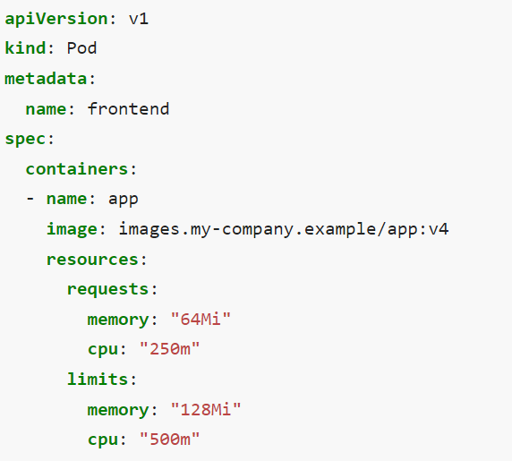
Resource request & limits on pods
Possible (and allowed) for a container to use more resource than its request
kube-scheduler uses this information to decide which node to place the Pod on
Request is minimum
A container is not allowed to use more than its resource limit.
Limits can be implemented either reactively
Additonal read: https://kubernetes.io/docs/concepts/configuration/manage-resources-containers/

Slide 43
Namespace
namespaces provides a mechanism for isolating groups of resources within a single cluster.
k get namespace
k get pods -n kube-system
Kubernetes starts with four initial namespaces
Default
Kube-node-lease
Kube-public
Kube-system
Kubectl create namespace mvj-test
Create pods in a specific namespace:
k run <podname> -n mvj-test --image=nginx
Permanently switch to a namespace:
kubectl config set-context –current –namespace=K21

Slide 44
Static pods
Pods for bootstrapping Kubernetes itself
k get namespace
k get pods -n kube-system
Pods that are managed by the control plane by default
Instead, the kubelet watches each static Pod (and restarts it if it fails)
Use "staticPodPath: <the directory>" field in the kubelet configuration file, which periodically scans the directory and creates/deletes static Pods

Slide 45
Mount volumes on pods
On-disk files in a container are ephemeral
When a pod ceases to exist, Kubernetes destroys ephemeral volumes
At its core, a volume is a directory, possibly with some data in it, which is accessible to the containers in a pod
A Pod can use any number of volume types simultaneously
A hostPath volume mounts a file or directory from the host node's filesystem into your Pod

Slide 46
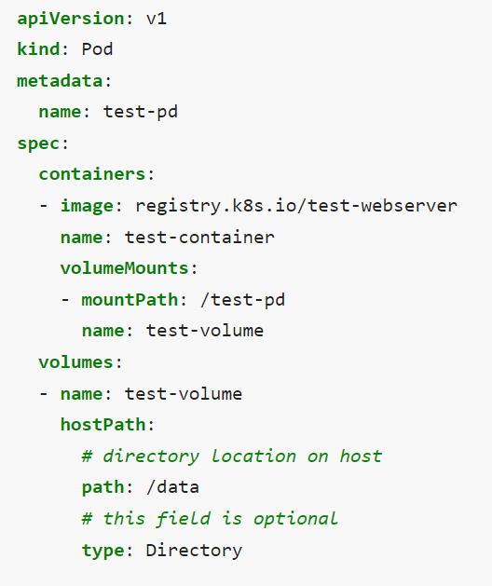
Volume mount

Slide 47
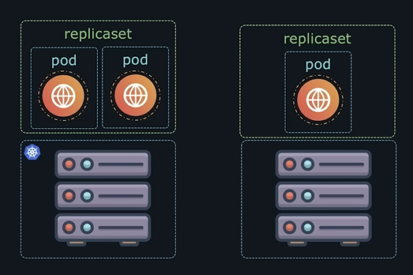
Replicaset
If the application crashes and pod fails ?
We would like to have more than one instance of the pods
Replicaset will bring up the pod back and ensure predefined # of pods are available at all the time
Even if you have single pod you can use replicaset. Replicaset will bring up pod back again when it crashes
RS can span across multiple nodes in a cluster
High availability and load sharing

Slide 48
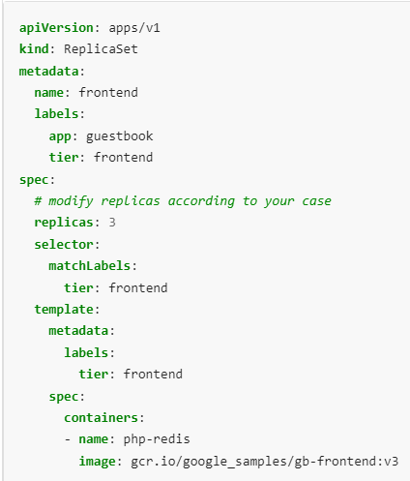
Create and test a replicaset
https://kubernetes.io/docs/concepts/workloads/controllers/replicaset/
Name: Test-Replica
Image: nginx
$ kubectl get rs
NAME DESIRED CURRENT READY AGE
frontend 3 3 3 2m17s
service-deployment-6799fc88d8 0 0 0 310d
Testing the replicaset : Delete a pod
Scale up/down replica set
kubectl scale --replicas=3 rs/foo
kubectl scale --replicas=3 rs/foo
Scaling based on load

Slide 49
Field upgrades
Users expect applications to be available all the time and developers are expected to deploy new versions of them several times a day. In Kubernetes this is done with rolling updates. Rolling updates allow Deployments' update to take place with zero downtime by incrementally updating Pods instances with new ones.
By default, the maximum number of Pods that can be unavailable during the update and the maximum number of new Pods that can be created, is one

Slide 50
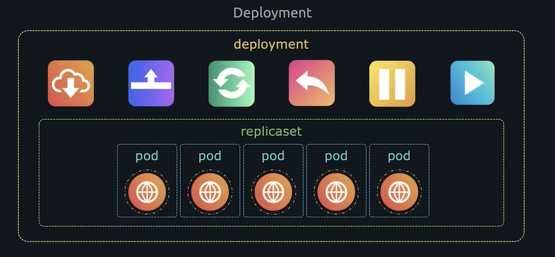
Deployment
When new version of application is released, you may want to upgrade
Seamlessly
Rolling upgrade
Roll back
All these capabilities are available in deployment
Definition file is like replica set

Slide 51
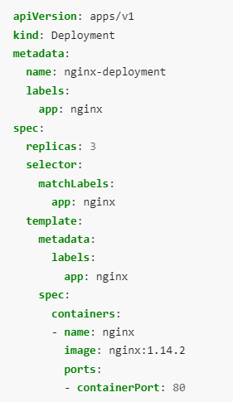
Deployment spec
Kubectl create –f deploy.yaml
Kubectl get deploy
Create new replicasets
Kubectl get all
Imperative way to upgrade the image
Kubectl set image deployment/<deployname> <container name>=nginx:1.9.1
https://kubernetes.io/docs/concepts/workloads/controllers/deployment/

Slide 52
Deployment rolling upgrade
Deployment roll out status
k rollout status deploy maninginx-deployment
Deployment roll out history
k rollout history deploy maninginx-deployment
StrategyType: RollingUpdate (Recreate)
RollingUpdateStrategy: 25% max unavailable, 25% max surge
Upgrading the deployment:
kubectl set image deploy maninginx-deployment nginx=nginx:1.9.1
k rollout history deploy maninginx-deployment
kubectl rollout undo deployments/kubernetes-bootcamp

Slide 53
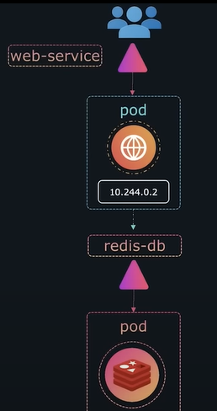
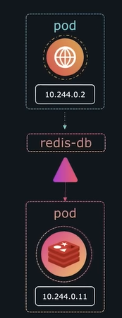
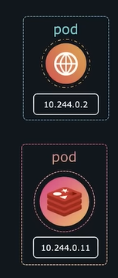
Services
Say we have a webserver and a Redis(DB) server
For webserver to access the redis server
Ips cannot be used since it may change
Service enables communication among pods(sometimes even for load balancing)
Communication within the application and outside the cluster

Slide 54
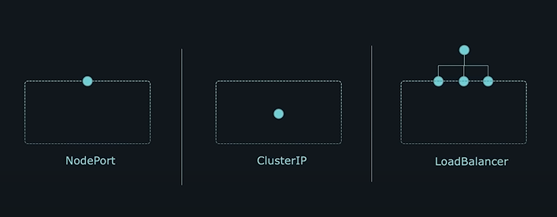
Service types
ClusterIP – Not exposed externally, for applications to communication
Nodeport: Exposes the application on port on Node
Load balancer: Provisions 3rd party loadbalancer

Slide 55
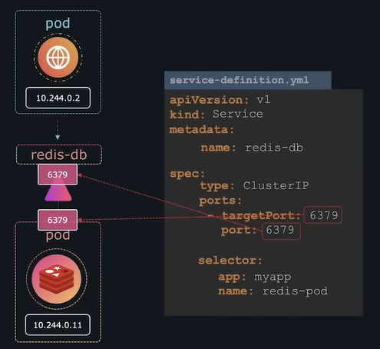
ClusterIP
How can a service identify the pods to route traffic
Pods have a label
Define the same label as a selector on the service
Selector to identify the port
Type: clusterIP(default)
Service name:

Slide 56
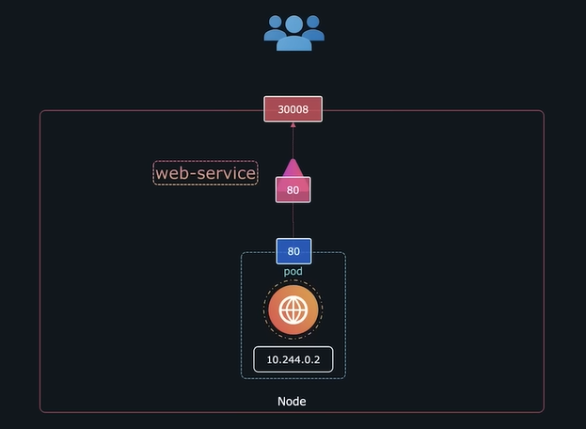
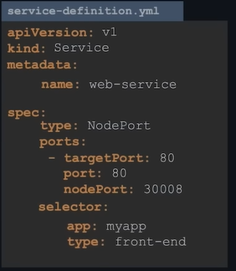
Node port
Type of service exposed to external user through a port on Node
30000- 32767
Selectors for pod selection links service to the pod

Slide 57
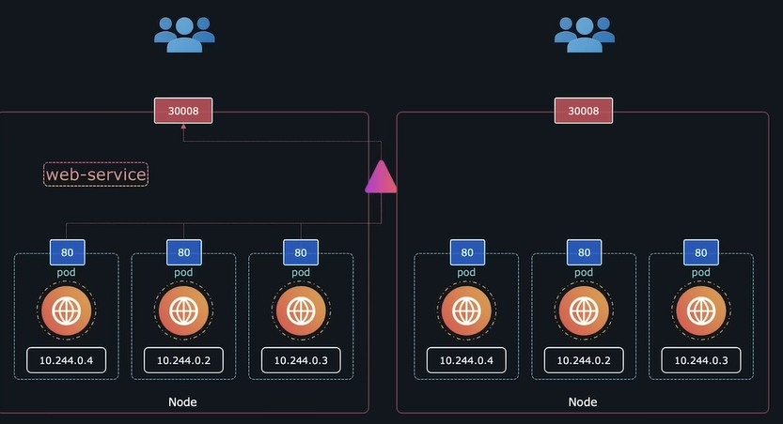
NodePort
Multiple instance of same pods
Labels on pods
Multiple pods single node
Multiple pods on multiple nodes
Balance load: random algorithm

Slide 58
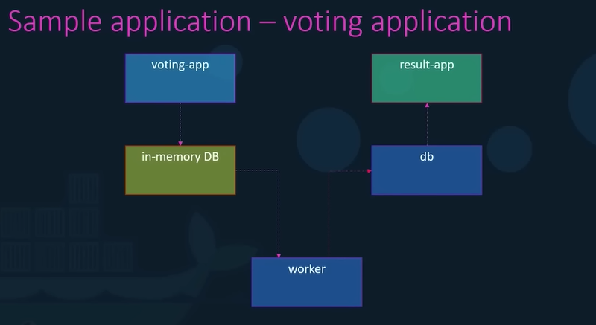
https://github.com/share2learnwidmanish/MVJ_K8_May19_2023/tree/main/example-voting-app-kubernetes-main/example-voting-app-kubernetes-main

Slide 59
Multi tier application
kubectl apply -f voting-app-deploy.yaml
kubectl apply -f result-app-deploy.yaml
kubectl apply -f worker-app-deploy.yaml
kubectl apply -f postgres-deploy.yaml
kubectl apply -f redis-deploy.yaml
kubectl apply -f redis-service.yaml
kubectl apply -f postgres-service.yaml
kubectl apply -f voting-app-service.yaml - Change the frontend port say 30004
kubectl apply -f result-app-service.yaml - Change the frontend port say 30005
Delete the entire deployment in one go
kubectl delete all --all
https://github.com/kodekloudhub/example-voting-app-kubernetes

Slide 60
Helm charts
A Helm chart is a set of YAML manifests and templates that describes Kubernetes resources (Deployments, Secrets, CRDs, etc.) and defined configurations needed for the Kubernetes application, and is also easy to deploy in a Kubernetes cluster or in a single node with just one command.
A chart is a set of Kubernetes yaml manifests packaged together for easy manipulation
helm install [app-name] [chart]

Slide 61
Backups and restore
etcdctl snapshot save snapshot.db
etcdctl snapshot restore -h snapshot.db

Slide 62
logs
K describe pod | grep –i events
K get events (all the pods)
Metrics Server installation
K top node
K top pod
Application logs:
Docker logs <contID>

Slide 63
Other related topics
Cluster networking
Secrets and config Maps
User management
Certificates management
Scheduler

Slide 64
References
https://kubernetes.io/docs/reference/kubectl/cheatsheet/
https://kubernetes.io/docs/concepts/workloads/pods/
Manifest files:
https://github.com/share2learnwidmanish/MVJ_K8_May19_2023

Slide 65
Backup

Slide 66
